Slide 1
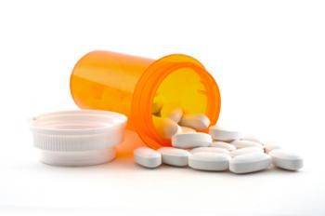
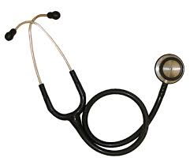
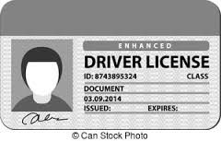
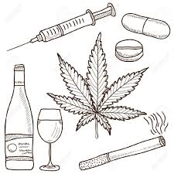
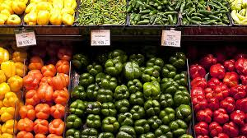
Get a job and/or go back to school/work
Medication or Medical Equipment
Legal Issues
Talk to someone about my Mental Health
Have Transportation
Have a better Living Situation
Have a better relationship with my doctor or nurses
See if I quality for Insurance and other Programs
Help people in my Community
Identification
Feel Supported
Learn more about my Medical health (diabetes, COPD, etc)
Talk to someone about my drug or alcohol use
Food & Nutrition

Slide 2
Talk to someone about my Mental Health
Medication or Medical Equipment
Get a job and/or go back to school/work
Legal Issues

Slide 3
Talk to someone about my Mental Health
Medication or Medical Equipment
To feel better about myself
To have more energy and motivation
Have fun and not worry all the time
Find medications that work for me
Get medical equipment that will help me manage my medical conditions
Get a job and/or go back to school/work
Legal Issues
Have spending money
Get an education
Work hard at a job I like
Get a lawyer
Stay out of jail
Get help with a legal issue

Slide 4
Have Transportation
Have a better Living Situation
Have a better relationship with my doctor or nurses

Slide 5
Have Transportation
Have a better Living Situation
Not have to rely on others to get places
To be able to get to medical appointment
Have a safe place to live
Find housing I can afford
Make improvements to where I live now
Have a better relationship with my doctor or nurses
Feel at ease in my healthcare providers office
Feel comfortable telling my providers I do not understand what they are telling me
WILD CARD

Slide 6
See if I quality for Insurance and other Programs
Help people in my Community
Identification
Feel Supported

Slide 7
See if I quality for Insurance and other Programs
Help people in my Community
Get involved or start a local interest group
Let people know what is happening in our area
Use my story to raise awareness
See if I can get financial assistance
Apply for health insurance
See what other help I can get
Identification
Feel Supported
Get a photo ID
Get a drivers license
Get a social security card
Get a birth certificate
Get proof of income
Socialize with friends and family
Find a good friend
Feel like my life matters to someone else

Slide 8
Learn more about my Medical health (diabetes, COPD, etc)
Food & Nutrition
Talk to someone about my drug or alcohol use

Slide 9
Learn more about my Medical health (diabetes, COPD, etc)
Food & Nutrition
Get access to healthy food
Eat better
Learn how to cook healthy food
To better control my pain
To live better day to day
To be physically fit
Talk to someone about my drug or alcohol use
Learn more about how the alcohol or drugs I use affect my health
Find someone to talk to about the alcohol or drugs I use

